Slide 1
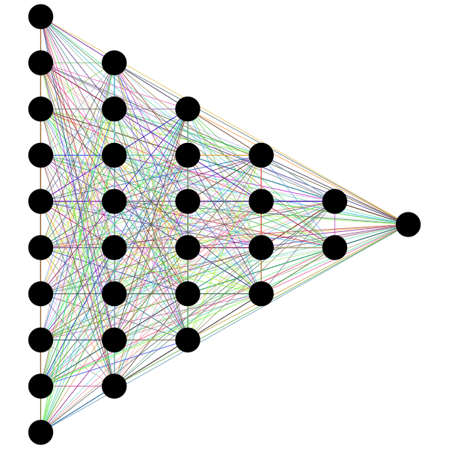
Spotify Music
Data Exploration with Machine Learning
Jerrica Raemer
Julia Olson
Brent Lang

Slide 2
Data Set
Information about music listened to over the course of 1 year
Data set comes from Kaggle and was scraped from Spotify
Music selection of a single person

Slide 3
Goal

Slide 4
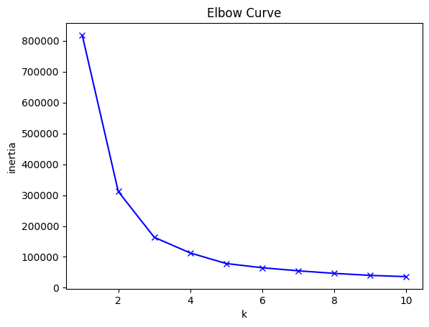
Model Choice
Unsupervised Learning using K-Means Clustering
Stripped out ‘trackName’, ‘artistName’, ‘id’, and ‘time signature’ columns
Elbow curve shows how many clusters we should use:
Elbow curve starts to flatten after 3.

Slide 5
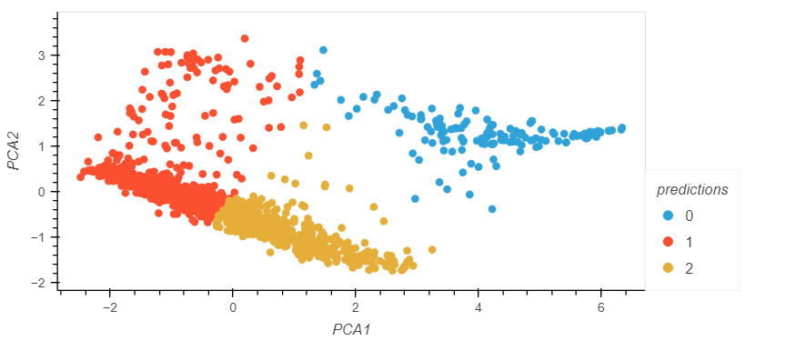
Clusters
We decided to make use of the Standard Scaler and Principal Component Analysis (PCA)
With PCA, we were able to compress our data to 3 columns
Our clusters are shown below:
We have 3 fairly distinct clusters.

Slide 6
Analysis

Slide 7
Conclusion

Slide 8
End Slide

Slide 9
Sources

